Slide 1


Hope to Skills
Lecture# 04
Irfan Malik, Dr. Sheraz Naseer

Slide 2
Google Bard
Bard is conversational AI chat service developed by Google.
While ChatGPT relies on its pre-trained knowledge, Bard pulls information from the internet in real-time.
Google Bard is powered by Google's very own and most advanced large language model (LLM) PaLM 2
https://bard.google.com/

Slide 3
Claude
Claude is a large language model (LLM) created by Anthropic.
An AI research company, with the overarching purpose of being a helpful conversational assistant.
https://poe.com/Claude%2B

Slide 4
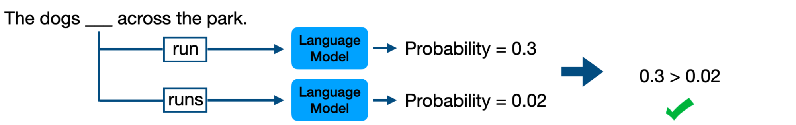
What is a Language Model?
Definition: A language model is an artificial intelligence model that predicts the probability of a sequence of words or tokens in a given context.

Slide 5
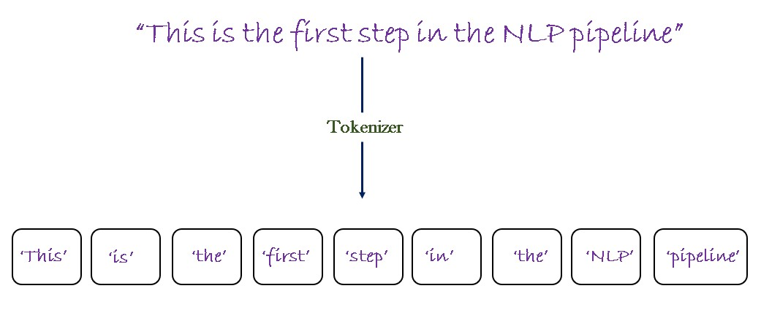
Tokenization
Definition: Tokenization is the process of breaking down text into smaller units called tokens, which can be words, phrases, or even characters.

Slide 6
Tokens in Language Models
Definition: Tokens are the fundamental units of text used by language models. They can be as short as a single character or as long as a word or phrase.
Importance: Language models process text at the token level, allowing them to analyze and generate text based on the context and relationships between individual tokens.

Slide 7
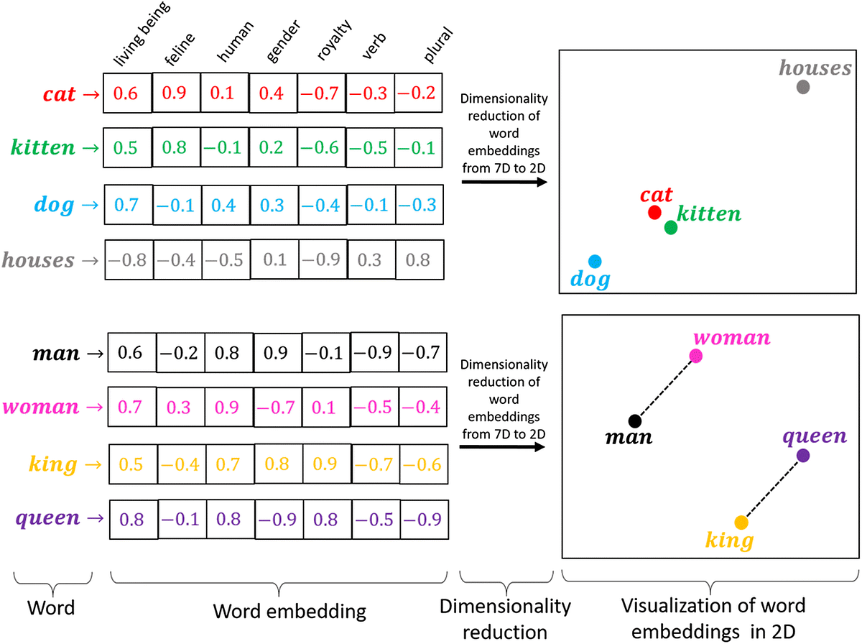
Embeddings from Tokens

Slide 8
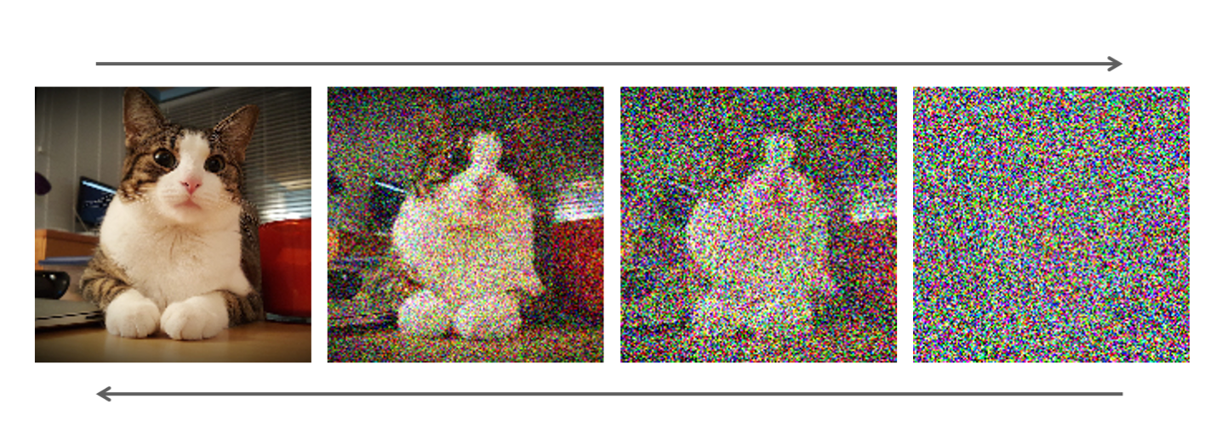
Diffusion Models
Forward
Backward

Slide 9
Introduction to Stable Diffusion
A cutting-edge image generation tool utilizing stable diffusion models.
Generates realistic and high-quality images through advanced diffusion techniques.
Allows users to explore the possibilities of image generation by controlling diffusion parameters.
Used in various fields including art, design, and computer vision for diverse image generation tasks.

Slide 10

Introduction to Stable Diffusion (Try it)

